Slide 1
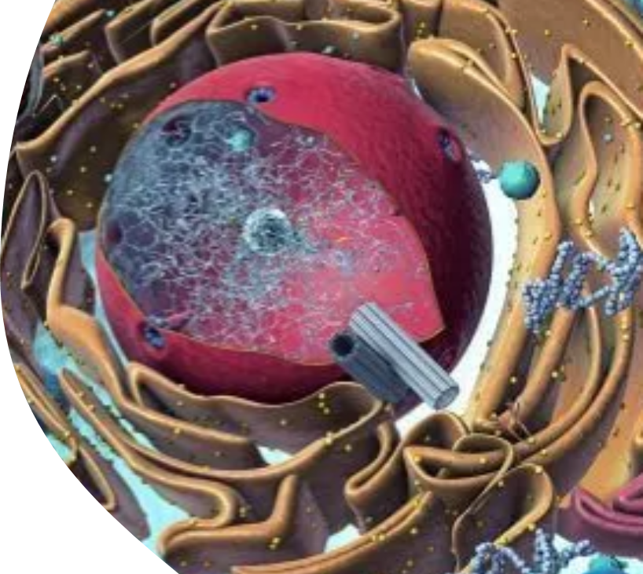
Organelles
AEHBY ATAR Human Biology

Slide 2
Review
State the cell theory.
List from simplest to most complex: system, tissue, cell, organ.
What contains similar cells with similar specialisation?
What contains different tissues working together?
Using the skeletal system, give an example from each level of organisation.

Slide 3
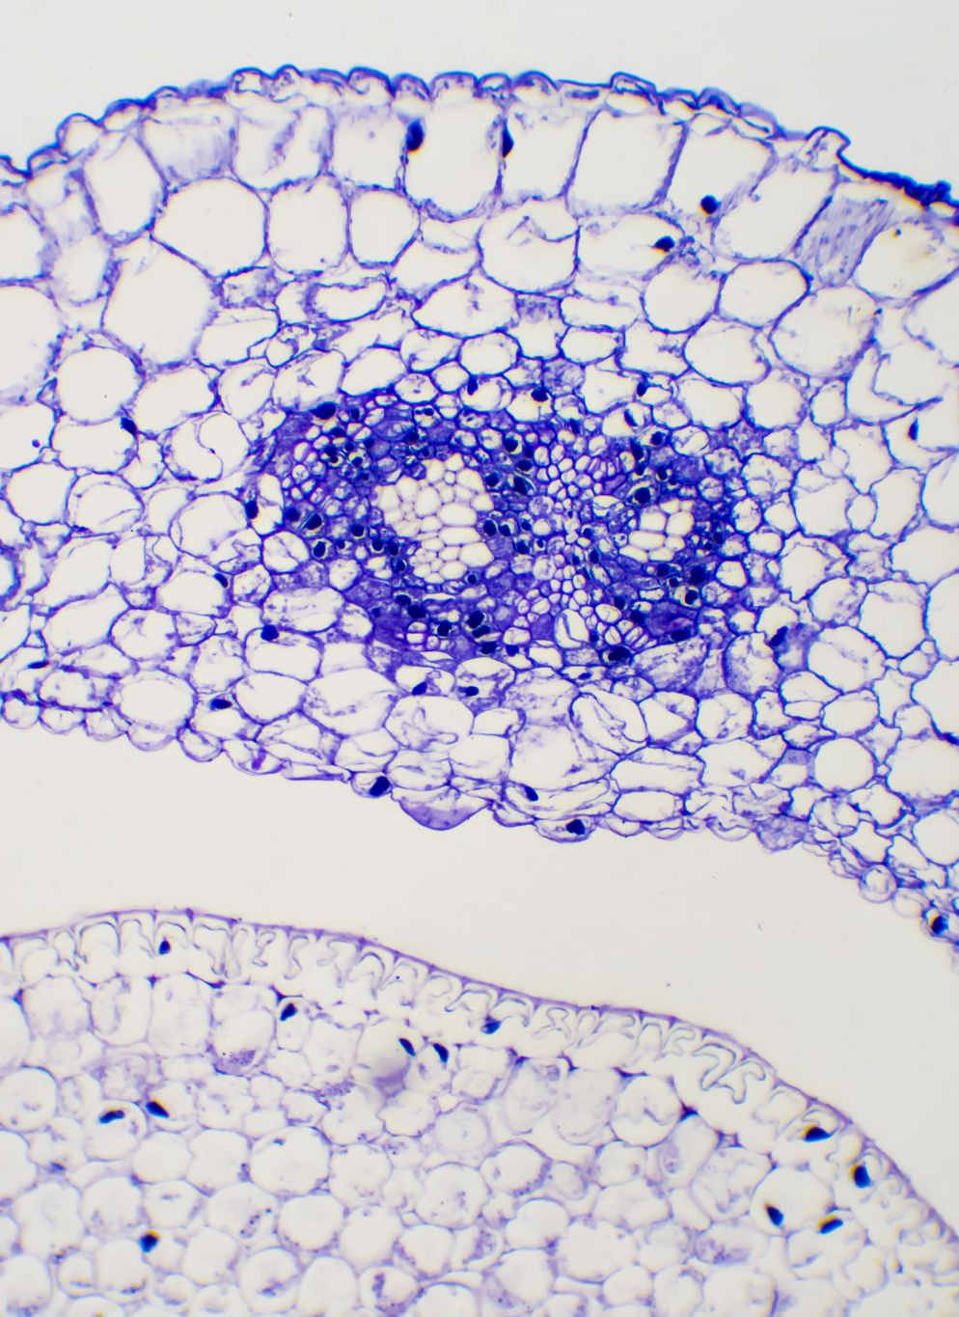
Learning Intentions
cell organelles maintain life processes and require the input of materials and the removal of wastes to support efficient functioning of the cell

Slide 4
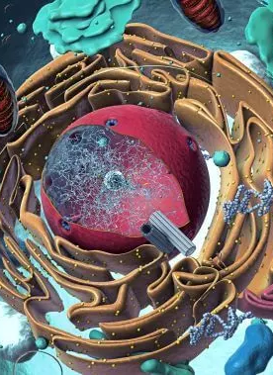
Success Criteria
Label organelles on a cell diagram
List the function of each organelle

Slide 5
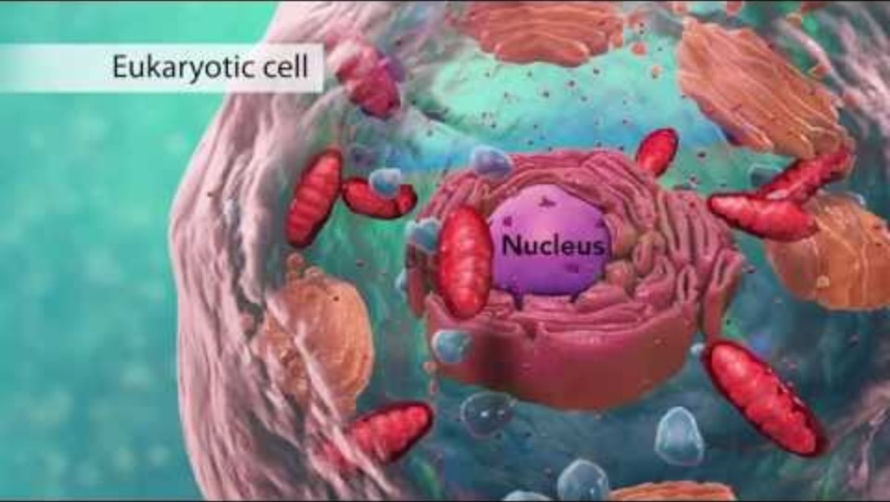
Organelles

Slide 6
Organelles
Animal Cell - Map Quiz Game - Seterra (geoguessr.com)

Slide 7
Success Criteria
Label organelles on a cell diagram
List the function of each organelle

